Slide 1

Nature-Inspired Algorithms to Optimize the Base Station Location Allocation Problem
Team Members
Enes Sağıroğlu
Utku Baygüven
Ahsen Yağmur Kahyaoğlu
Advisor
Asst. Prof. Fatma Corut Ergin

Slide 2
AGENDA
Introduction to the Project
Problem Statement and Motivation
Project Aims
Related Work
Project Scope
Methodology and Technical Approach
Tasks Accomplished
Difficulties Encountered
Future Work and Second Semester Plans
Q&A
References

Slide 3

Introduction to the Project
Our project focuses on strategically placing base stations for better communication networks, especially during emergencies.
We aim to use nature-inspired algorithms to find a cost-effective and efficient solution that improves emergency call (112 calls) routing and response.

Slide 4

Problem Statement and Motivation
Problem Statement:
We're tackling the challenge of expanding communication networks by figuring out the best places to set up base stations.
Motivation:
Our goal is to create a wide-reaching, affordable network that can handle lots of calls during emergencies, because fast and dependable emergency responses are crucial for keeping people safe.

Slide 5
Project Aims
Research and Analysis
Scenario Development
Data Compilation
Simulation of Emergency Demands
Algorithm Implementation
Testing and Environment Setup
Algorithm Execution
Performance Analysis
Our primary goal is to utilize nature-inspired algorithms to optimize the placement of base stations, ensuring broad coverage for emergency calls at minimal costs.

Slide 6
Project Scope
Our scope includes:
Optimal Base Station Placement
Emergency Call Routing
Our project will not cover:
Non-Emergency Communication Routing
Physical Infrastructure
Alternate Networks
Assumptions:
Data Access
Regulatory Compliance
User Volume
Constraints
Computational Resources
Project Timeline
Budget

Slide 7
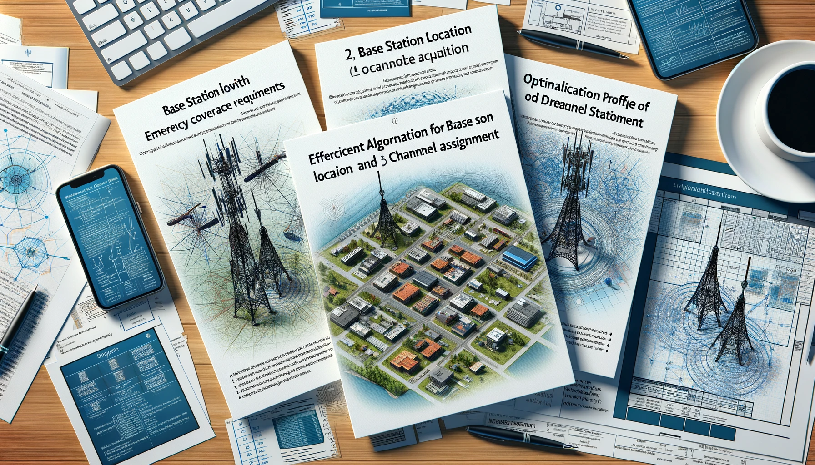
RELATED WORK
Base station location and channel allocation in a cellular network with emergency coverage requirements [1]
An Efficient Algorithm to Solve Base Station Location and Channel Assignment Problems in a Cellular Network [2]
Optimal Network Design: the Base Station Placement Problem [3]
The location-allocation problem of drone base stations [4]

Slide 8
Methodology and Technical Approach
Research and Data Collection:
Geographic and demographic data.
Data on existing base station models, costs, and strategies.
Scenario Development:
Three different scenarios (small, medium, and large scale)
Potential base station locations, accounting for population density and terrain, and include emergency call nodes
Dataset Creation:
We will use comprehensive dataset that reflects real-world complexities will be created

Slide 9
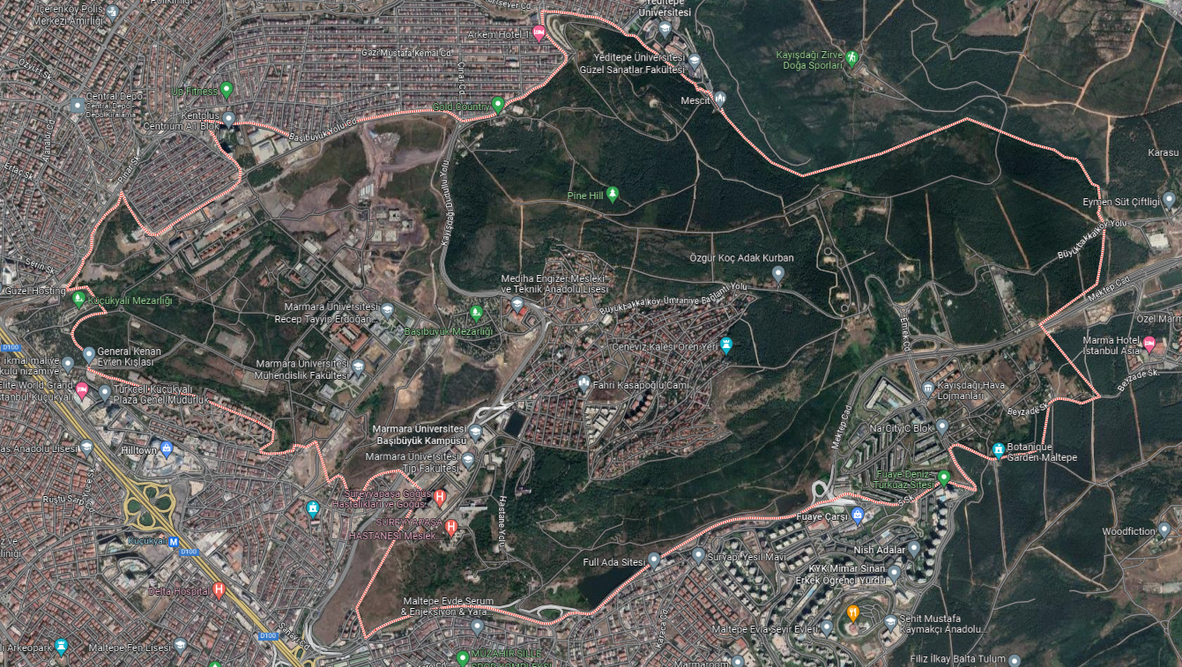
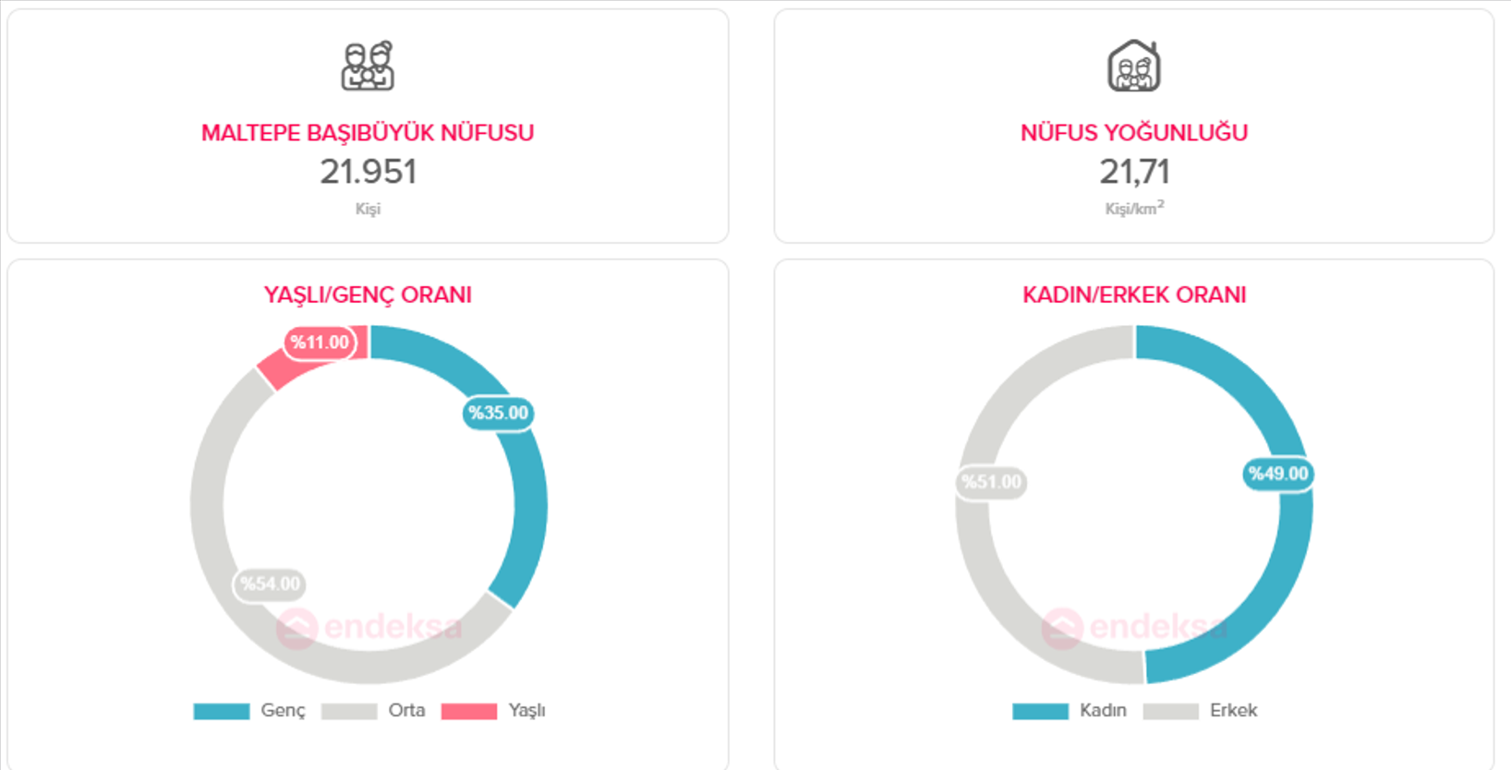
Figure 1 [5]
Map of Başıbüyük district
Figure 2 [6]
Population information of the region

Slide 10
Methodology and TechnIcal Approach
Algorithm Selection and Implementation:
We will select and implement a nature-inspired algorithm
Such as Genetic Algorithm (GA), Particle Swarm Optimization (PSO), and Ant Colony Optimization (ACO).
Simulation and Optimization:
The chosen algorithm will be simulated in a controlled environment.
Performance Evaluation:
Performance evaluated based on coverage area, cost efficiency, and emergency response time.
Resource Allocation:
Computational facilities and simulation software (e.g., MATLAB or Python-based tools), will be identified and used.

Slide 11

Tasks Accomplished
We have developed our simulation model.
To conduct the simulation, we identified three distinct regions.
In these regions, we created two different scenarios.
Scenario 1 represents the daytime hours when teletraffic is dense
Scenario 2 corresponds to the nighttime hours when teletraffic is sparse.
We have also gathered population information related to these selected regions.

Slide 12
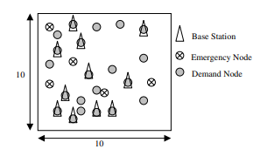
Difficulties Encountered
Dataset Preparation:
During the project, we faced significant challenges in finding a suitable dataset. As a result, we had to create our own dataset.
“Base station location and channel allocation in a cellular network with emergency coverage requirements” - Instance Generator
Figure 3 [1]

Slide 13
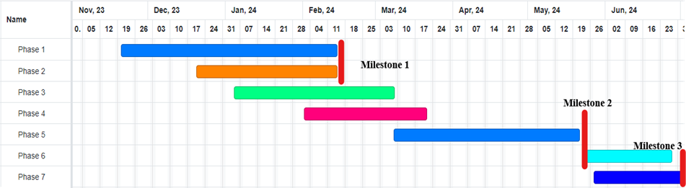
Future Work and Second Semester Plans
Milestone 1: Algorithm Customization and Theoretical Model Development.
Milestone 2: Algorithm Testing and Refinement on prepared dataset.
Milestone 3: Performance Evaluation, Analysis and documentation preparation.

Slide 14

Thank you for listening! any questions?

Slide 15
references
[1] M. R. Akella, R. Batta, E. M. Delmelle, P. A. Rogerson, A. Blatt, and G. Wilson, 'Base station location and channel allocation in a cellular network with emergency coverage requirements,’ European Journal of Operational Research, vol. 164, no. 2,pp. 301-323, 2005, https://doi.org/10.1016/j.ejor.2003.12.014
[2] R. Aboolian and S. Lou, "An efficient algorithm to solve base station location and channel assignment problems in a cellular network," International Journal of Management and Network Economics, vol. 1, pp. 176-185, 2009. DOI:10.1504/IJMNE.2009.024783.
[3] S.-T. Yang and A. Ephremides, "Optimal Network Design: the Base Station Placement Problem," in Proceedings of the 36th Conference on Decision & Control, San Diego, California, USA, December 1997. Institute for Systems Research and Electrical Engineering Department, University of Maryland, College Park.
[4] C. T. Cicek, H. Gultekin, and B. Tavli, "The location-allocation problem of drone base stations," Computers & Operations Research, vol. 111, pp. 155-176, 2019. ISSN0305-0548. DOI: 10.1016/j.cor.2019.06.010. [Online]. Available: https://www.sciencedirect.com/science/article/pii/S0305054819301704
[5] Google Maps, 'Map information for Başibüyük.' [Online]. Available: https://maps.app.goo.gl/2Jxgoj3yTHKM8Tdk9
[6] 'Demographics of Maltepe, Başibüyük, Istanbul,' Endeksa, 2023. [Online] Available: https://www.endeksa.com/tr/analiz/turkiye/istanbul/maltepe/basibuyuk/demografi.

